Slide 1
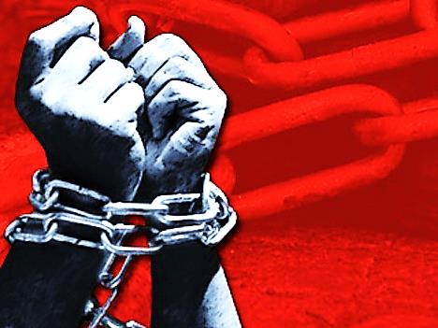
Moses (Sin Enslaves but Jesus Sets Us Free)

Slide 2
Note: After you download the slideshow, you may also need to download some videos from YouTube & add them into this PowerPoint. This tool can help you: Free YouTube Download
We present these messages in outdoor venues using the SonShineTent. Watch the video of our service that goes with this message, click here: http://campaignkerusso.org/?p=10406
We would love to know more about the people who download our lessons & sermons. We invite you to email us & let us know where & how you use them.
info@campaignkerusso.org

Slide 3
Welcome All

Slide 4
Let’s Begin with Prayer

Slide 5
Moses (Sin Enslaves but Jesus Sets Us Free)

Slide 6
Song: Go Down Moses
Video Goes Here Title: Go Down Moses Download Here:
https://www.youtube.com/watch?v=vf6jBP4YXwo

Slide 7
Song: Pharaoh Pharoah
Video Goes Here Title: Pharaoh Pharoah Download Here:
https://www.youtube.com/watch?v=y7O4kWKTNPA

Slide 8
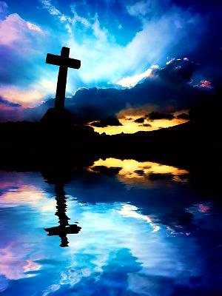
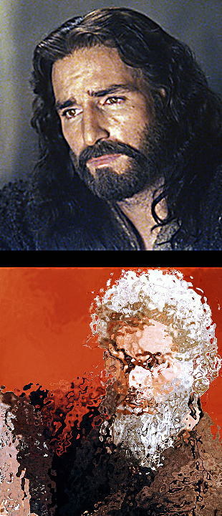
Moses is a Mere Reflection of Jesus to Come

Slide 9
Moses is a Mere Reflection of Jesus to Come
Moses said:
“The Lord your God will send you a prophet, an Israelite like me. You must listen to him.”
Deut. 18:15

Slide 10
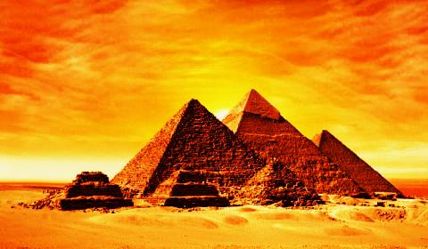
Just as Jesus was called to save men from the bondage of their sins, Moses was called to save the Jews from the bondage of slavery in Egypt.

Slide 11
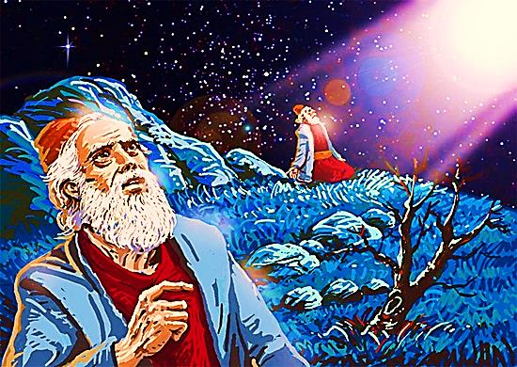
“God said to Abram, ‘Know for sure that your children and those born after them will be strangers in a land that is not theirs. There, they will be servants and suffer for 400 years.”’ Gen 15:13

Slide 12
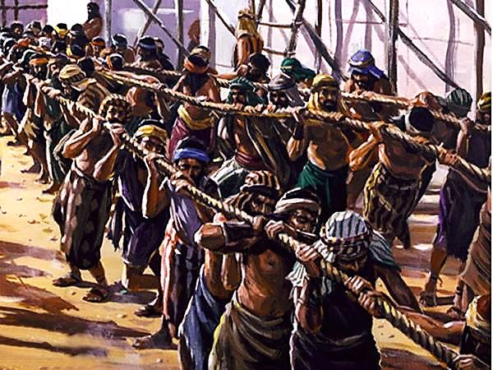
Exodus Means: “To Get Out”
We are going to learn how the Israelites got out of Egypt & slavery.

Slide 13
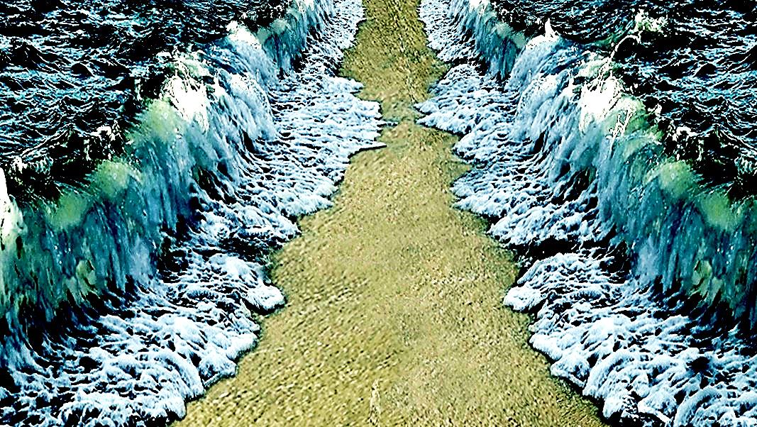
“I am the Lord your God, Who brought you out of the land of Egypt, out of the house where you were servants”
Ex. 20: 2

Slide 14
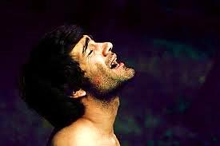
God always hears true prayer:
“A long time passed and that king of Egypt died. But the Israelites were still forced to work very hard. They cried for help, and God heard them.” Ex. 2:23
“The Lord said, “I have seen the suffering of My people in Egypt. I have heard their cry because of the men who make them work. I know how they suffer.” Ex. 3:7

Slide 15
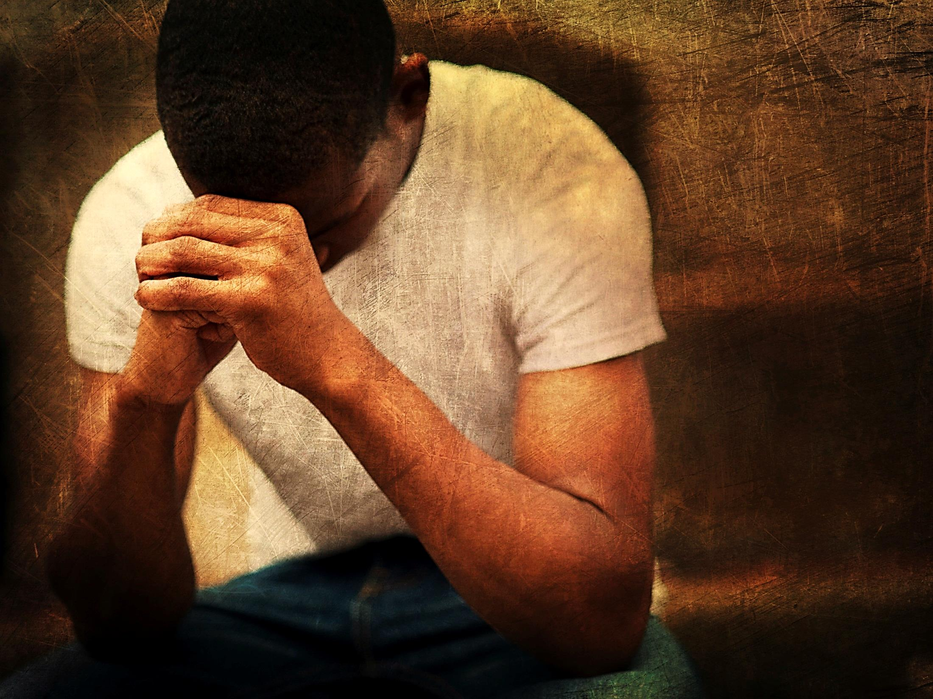
He heard their prayers and He hears ours:
“In my trouble I called to the Lord. Yes, I cried out to my God for help. There in his temple he heard my voice. He heard my cry for help.” 2 Sam. 22:7

Slide 16
“Don't think that the Lord is too weak to save you or too deaf to hear your call for help!” Isa 59:1
“Here is a poor man who called out. The Lord heard him and saved him from all his troubles.”
Psalm 34:6

Slide 17
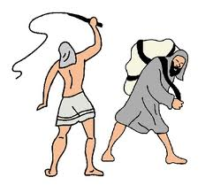
Like Jesus, Moses cared about the suffering of his people:
“When he was forty years old, he thought he should visit his brothers, the Jews. He saw one of the Jews being hurt. Moses helped the Jew and killed the man from Egypt.”
Acts 7:23.24
He tried to save the Hebrew with his own power, but the problem was too big for Moses alone. It would take miracles.

Slide 18
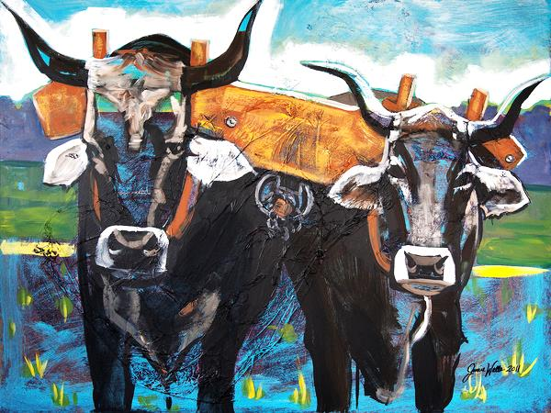
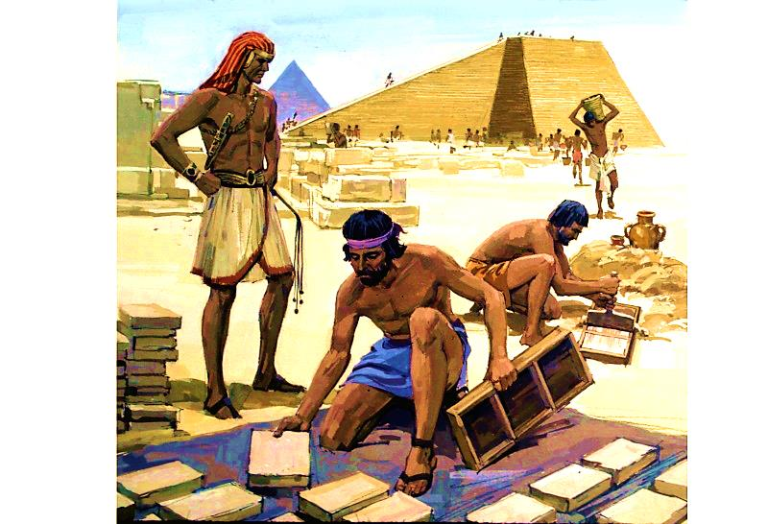
“I am the Lord your God, who brought you out of the land of Egypt so you would no longer be their slaves. I broke the YOKE of slavery from your neck so you can walk with your heads held high.” Lev. 26:13

Slide 19
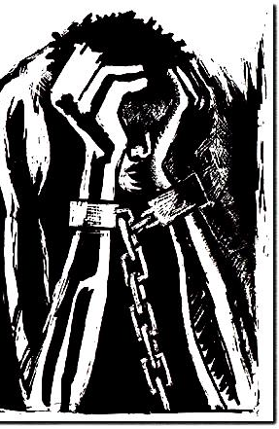
Jesus says that we are still slaves if we allow sin in our lives. We become slaves to sin.
Sin is when we want to be in charge of our lives without God.
But, without God, we are unable to free ourselves from sin.
We become slaves to sin. We may even want to stop, but we can’t—sin controls us.

Slide 20
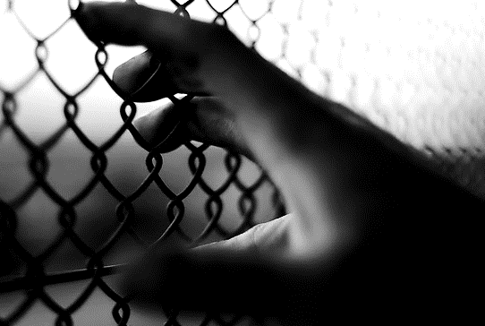
His own sins will trap the sinful. He will be held with the ropes of his sin. Pv. 5:22
Jesus answered them, "For sure, I tell you, everyone who sins is the servant of sin because sin has a hold on him. Jn. 8:34

Slide 21
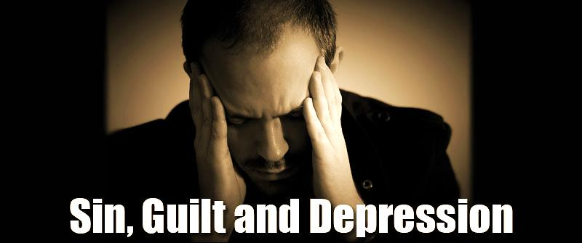
Just as God used Moses to set the slaves of Egypt free, He used Jesus to set us free from slavery to sin!
“Come to me, all of you who are tired from carrying heavy loads, and I will give you rest.” Mat. 11:28
“Take my yoke upon you. Let me teach you, because I am humble and gentle at heart, and you will find rest for your souls.” Mat. 11:29

Slide 22
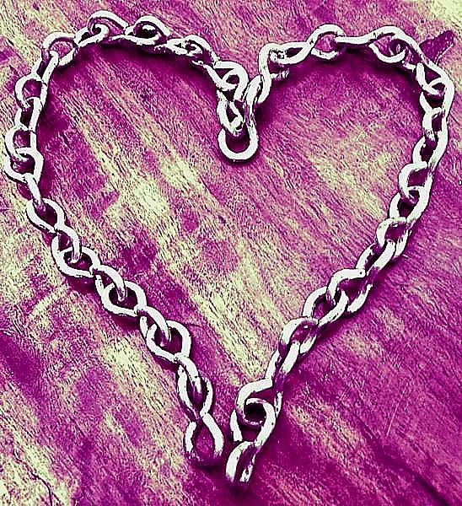
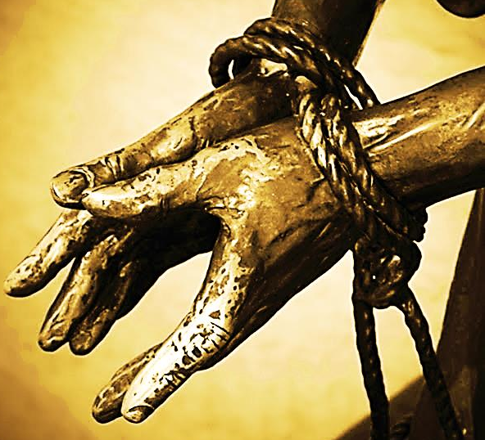
Jesus won our service with chains of love.
“I led them with ropes, but they were ropes of love. I was like a person who set them free. I bent down and fed them..” Hos. 11:4

Slide 24
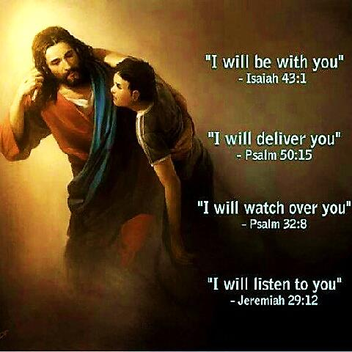
He is Our Master, yet He Does all the Work!

Slide 25
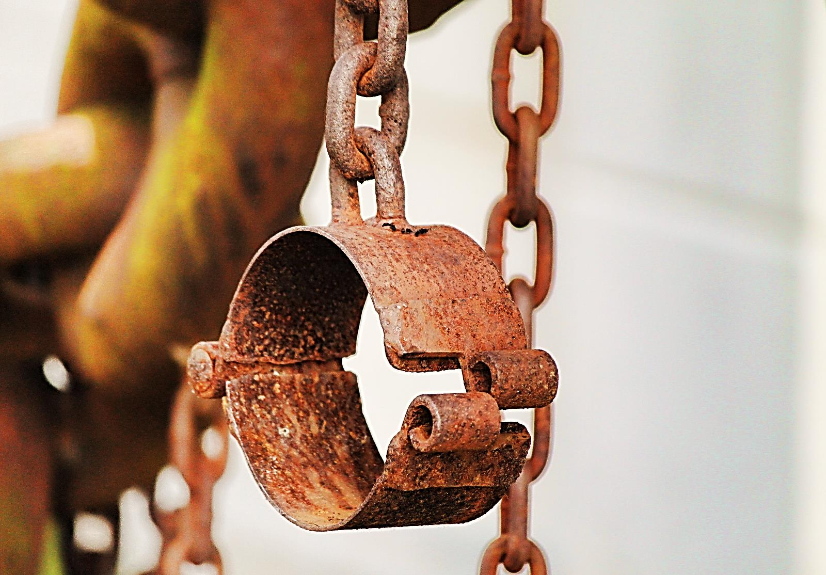
“So if the Son makes you free, you are really free.”
John 8:36

Slide 26
Song: Set Me Free
Video Goes Here Title: Set Me Free Download Here:
https://youtu.be/7mhls8G-aBU

Slide 27
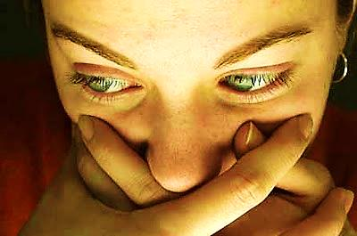
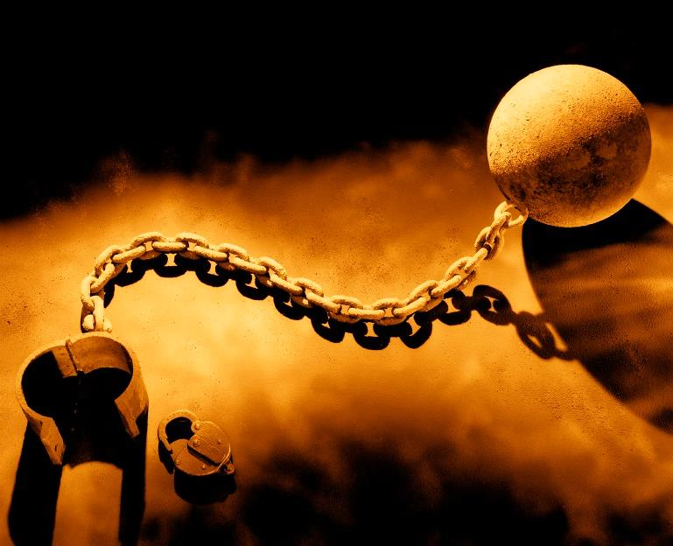
Never Go Back to Slavery!
“We have freedom now, because Christ made us free. So stand strong in that freedom. Don’t go back into slavery again.” Gal. 5:1

Slide 28
Song: The Sin Chair
Video Goes Here Title: The Sin Chair Download Here:
https://youtu.be/0Lokdp2dCqQ

Slide 29
Song: Remember Your Chains
Video Goes Here Title: Remember Your Chains Download Here:
http://youtu.be/4FRAYGLMjP4

Slide 30
Is Jesus
Speaking to You?
“They said to each other, ‘Did not our hearts burn within us while he talked to us on the road, while he opened to us the Scriptures?’”
John Wesley Said:
“…the preacher was describing the change which God works in the heart through faith in Christ and I felt my heart strangely warmed.”
Jesus makes His presence Known by a small voice!

Slide 32
What is the Sinner‘s Prayer?
This is a prayer we can pray when we are ready to admit we are sinners and need Christ’s forgiveness.
It must be prayed with faith in our hearts and a readiness to have a life-changing encounter with Jesus Christ.

Slide 33
A prayer of faith → Pray this prayer if :
If you never have before
You have in the past, but you think it would mean more today
You have been walking afar off and you want to come back
You want to set an example & show others how it is done
You just like to give your heart to Jesus again & again
Faith

Slide 34
We Declare Our Faith Publicly Because Jesus Declared His LOVE Publicly
“If you stand before others and are willing to say you believe in me, then I will tell my Father in heaven that you belong to me.” Mat 10:32

Slide 35
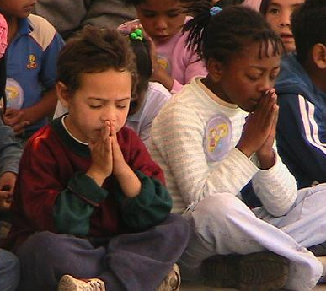
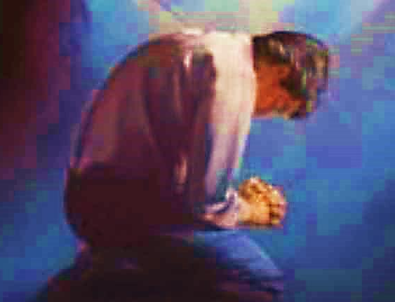
Three Important Questions
Do you want to know Jesus as your Savior right now?
Do you believe He died to save you from your sins & that He rose from the dead?
Do you believe that He is here, waiting to save you right now?

Slide 36
The Prayer of a Sinner Turning to Jesus
Dear Jesus, I know that I have sinned against You and that my sins separate me from You.
I am truly sorry.
Right now, I turn away from my sinful past .
Please forgive me, and help me to keep from sin.
I believe You died for my sins.
I Believe You rose from the dead, you are alive, and you hear this prayer from my heart.
I invite You Jesus to be both my Savior and the Lord of my life.
I want You to rule my life from now on.

Slide 37
“But some people did accept him. They believed in him, and he gave them the right to become children of God.”
John 1:12

Slide 39
“If you openly say, ‘Jesus is Lord’ and believe in your heart that God raised him from death, you will be saved.”
Rom. 10:9
What did you learn today?
What about sin’s bondage?
What have you been thinking about God lately?
What do you want to tell others about Jesus?

Slide 40
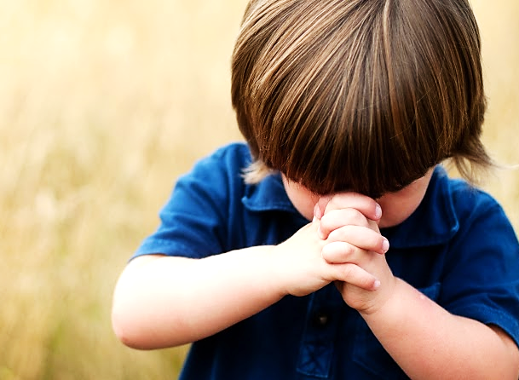
Let’s Close in Prayer

Slide 41
Note: After you download the slideshow, you may also need to download some videos from YouTube & add them into this PowerPoint. This tool can help you: Free YouTube Download
We present these messages in outdoor venues using the SonShineTent. Watch the video of our service that goes with this message, click here: http://campaignkerusso.org/?p=10406
We would love to know more about the people who download our lessons & sermons. We invite you to email us & let us know where & how you use them.
info@campaignkerusso.org

